Slide 1
Round Table Discussion Topics
NCITE Geometric Design Committee
February 20, 2017

Slide 2
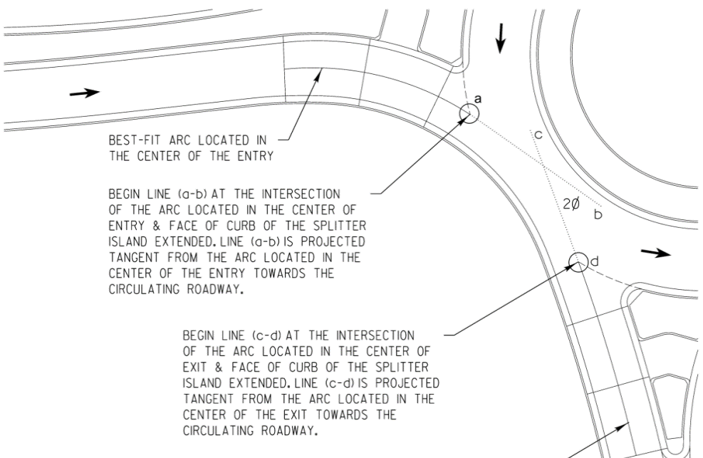
Phi Angles
Not a controlling criteria
A gauge of sight to the left
A gauge of ease of entry to the right
Reduces cost
Reduces capacity?
20-30°, 25° preferred
Notes:
20-30 degrees, 25 preferred

Slide 3
Approach Deflection
“For the single-lane roundabouts that did result in a higher crash frequency, there was little deflection or speed reduction on the entry paths to the roundabout.” NCHRP 572
“…balancing the need to achieve deflection with providing adequate alignment of the natural vehicle paths.” NCHRP 672

Slide 4
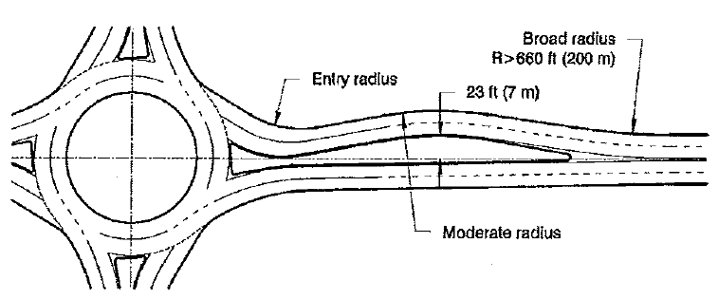
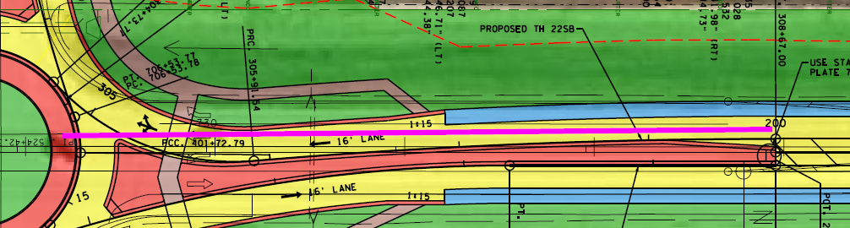
Approach Deflection

Slide 5
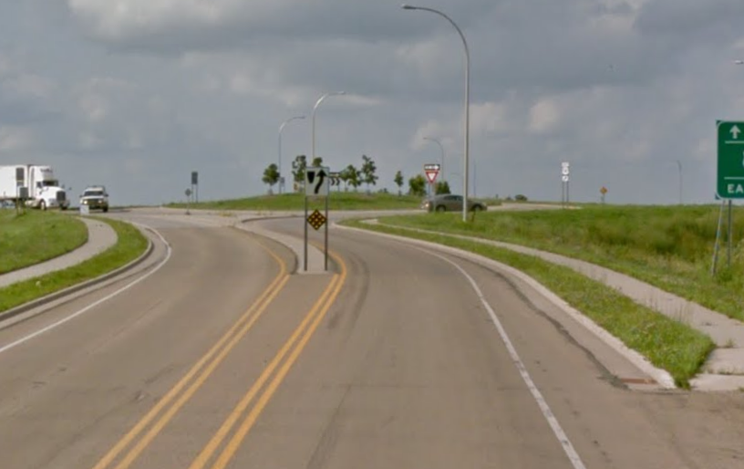
Approach Deflection

Slide 6
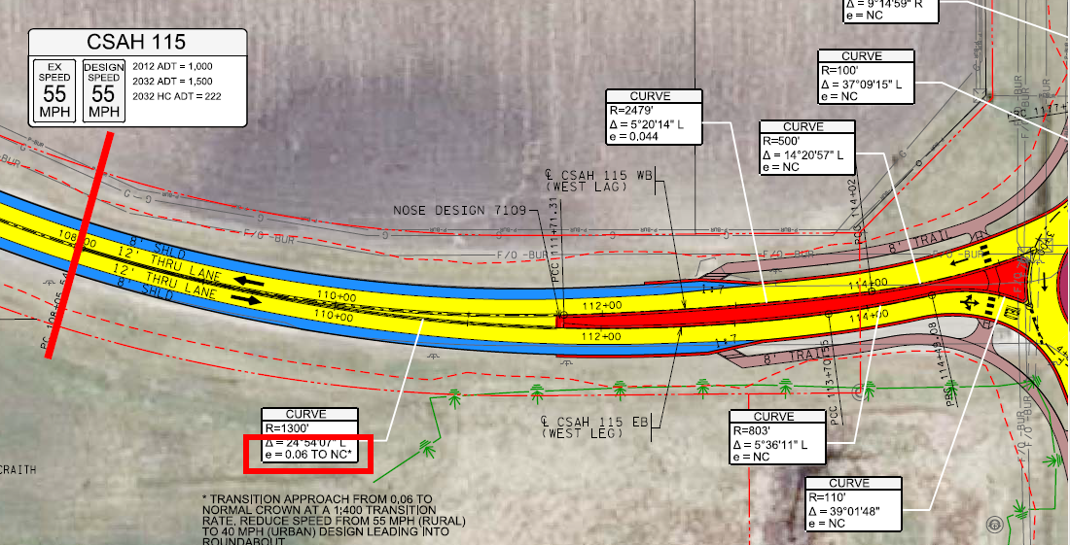
Approach Design Speed

Slide 7
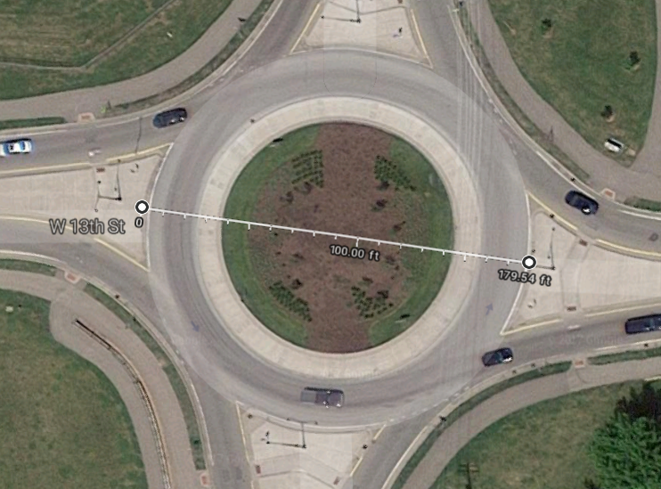
Central Island Size
Single lane: 150-165
Multilane: 180-200

Slide 8
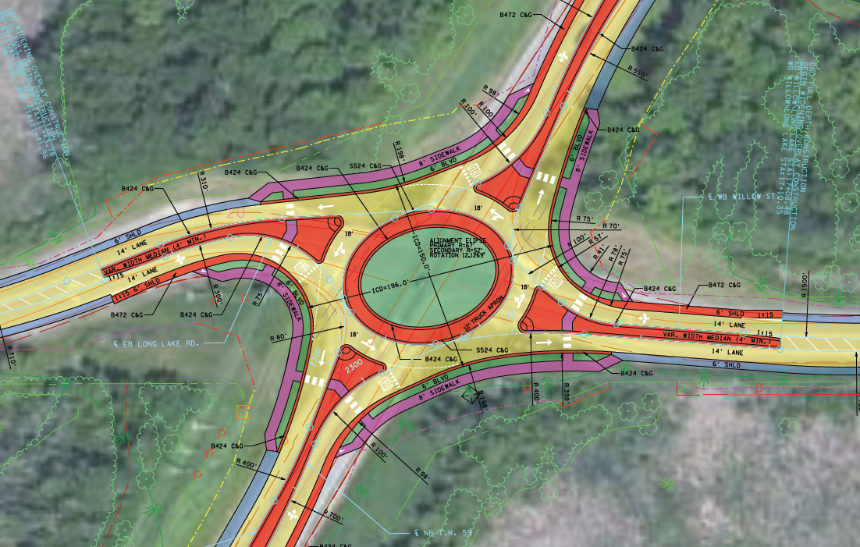
Non-traditional Shape

Slide 9
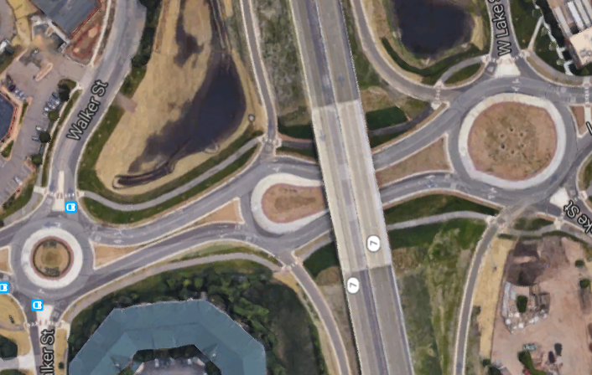
Non-traditional Shape
Flare
Teardrop

Slide 10
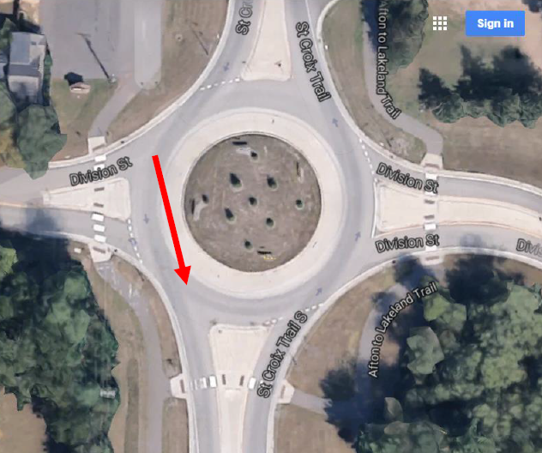
Tangential Exit Geometry
200-400’ exit curves
Tangent to exit

Slide 11
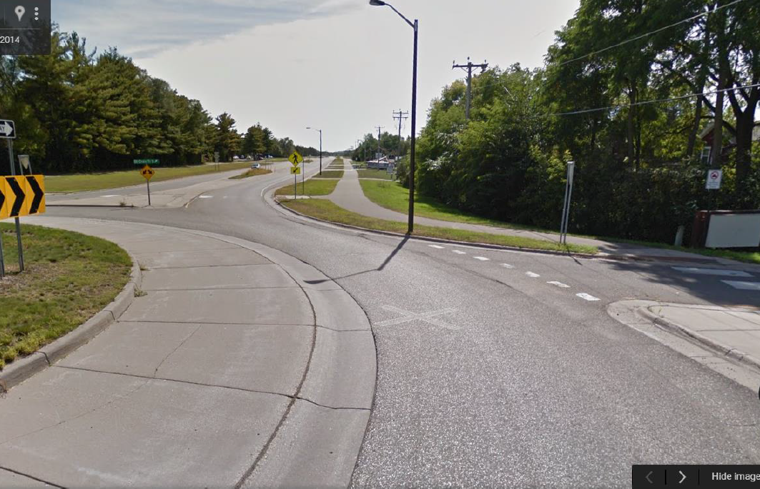
Tangential Exit Geometry

Slide 12
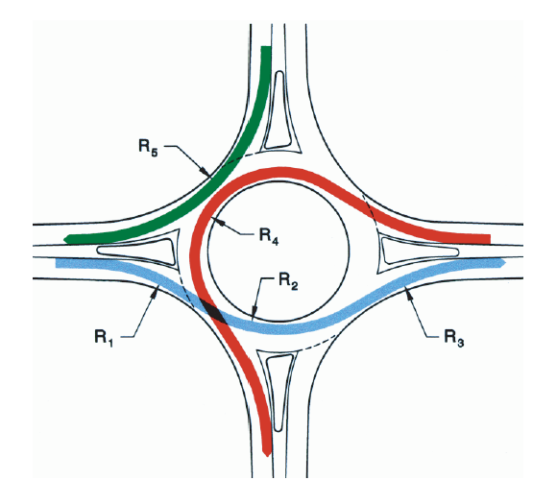
Rigid Adherence?
R1 & R2 speeds dictate R3 & R4 speeds
R5 often set by truck turns
Vane striping used to minimize R5

Slide 13
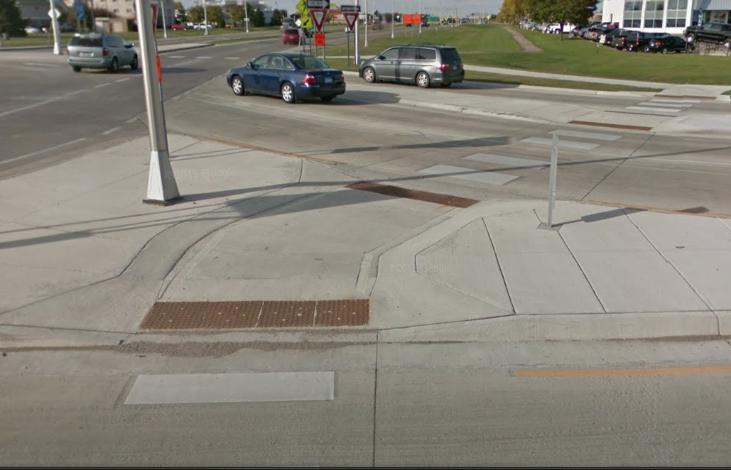
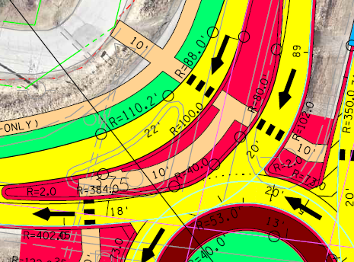
Bikes & Peds
Simple outlet downstream
Minimize curb upstream
Limit to 50’
Ramps Preferred to cut through
Redirect at center
Avoid free right with peds
Offset better than free right

Slide 14
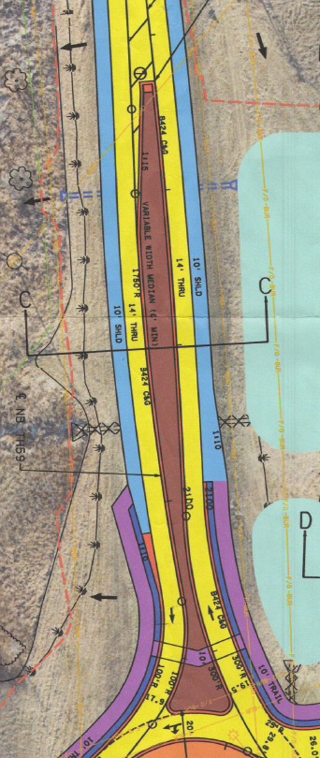
Bikes & Peds

Slide 15
Common Mistakes
Designers have gotten pretty good overall
Overdesigned
  Unnecessary lanes
  Unnecessary free rights
Large raised medians
Flat or exaggerated approach geometry
Underutilized truck aprons
Most appropriate solution?

Slide 16

Rule of Thumb
Approach medians
  350’ High speed
  200’ Low speed
Entry Radius 90-110°
1000 conflicting vehicles
Left offset approach
22’ entry width
20’ circulatory roadway
13-14’ truck apron, 1%
1.5% landings

Slide 17
Convert Single to Multilane
Design ultimate condition first
In to Out
  Minimize initial cost
  Most efficient design*
  Central island in final configuration
Out to In
  r/w footprint set
  Drainage and ped in final condition
Likelihood of conversion?

Slide 18
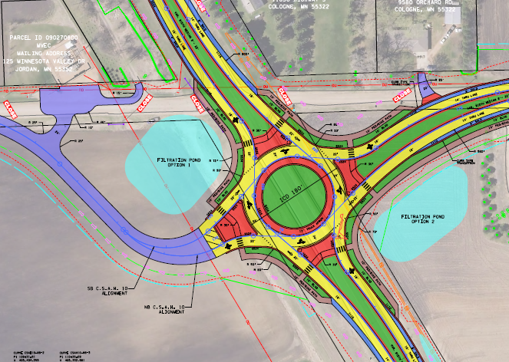
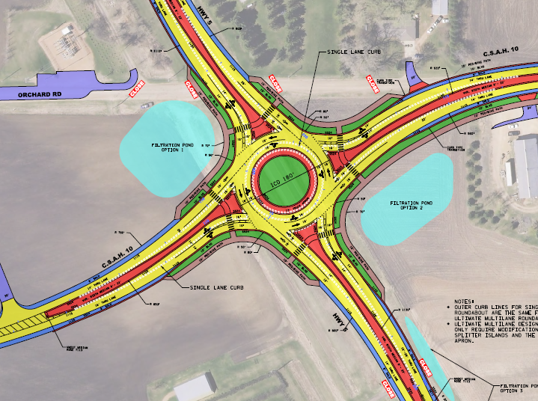
Convert Single to Multilane

Slide 19
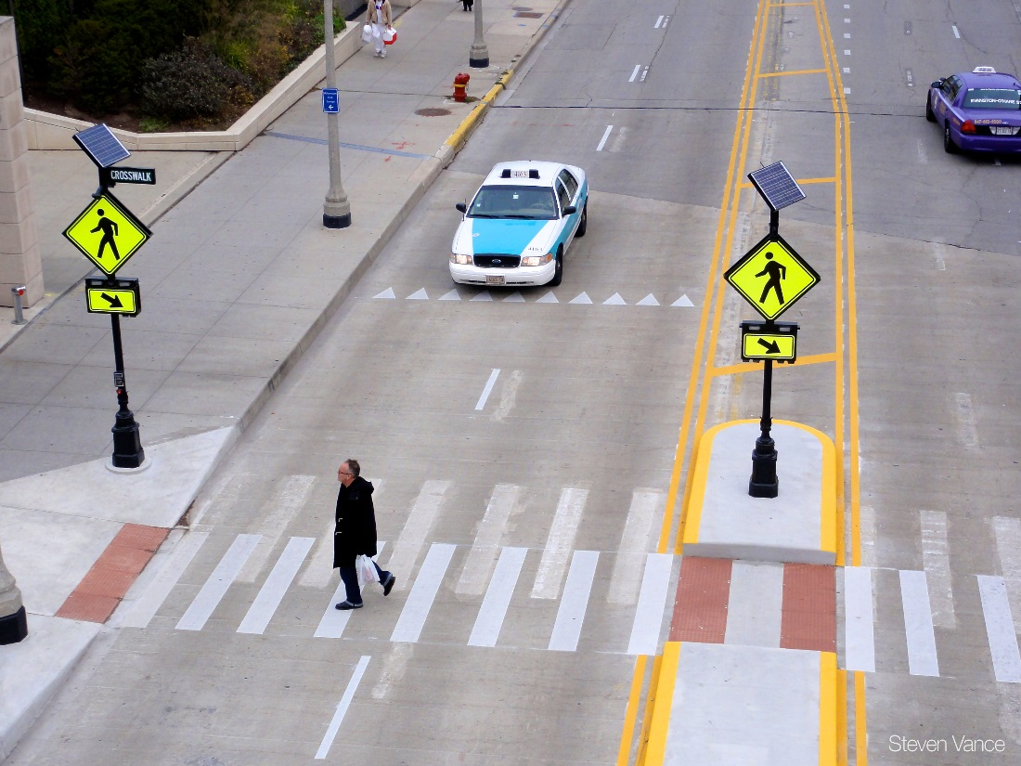
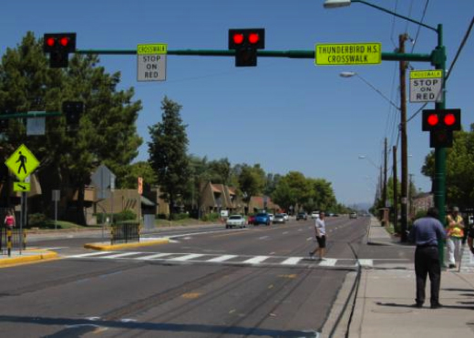
Signalized Pedestrian Crossings

Slide 20
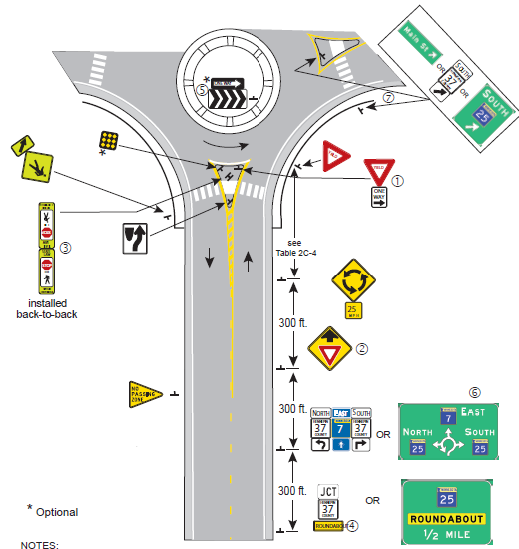
Required Signing

Slide 21
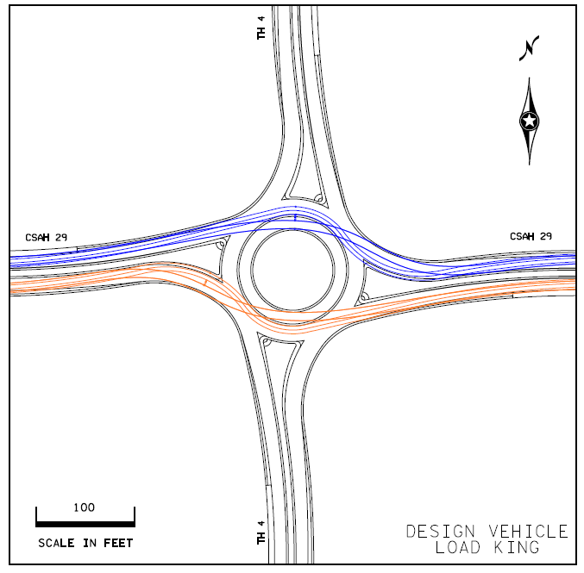
Bonus Topic

Slide 22
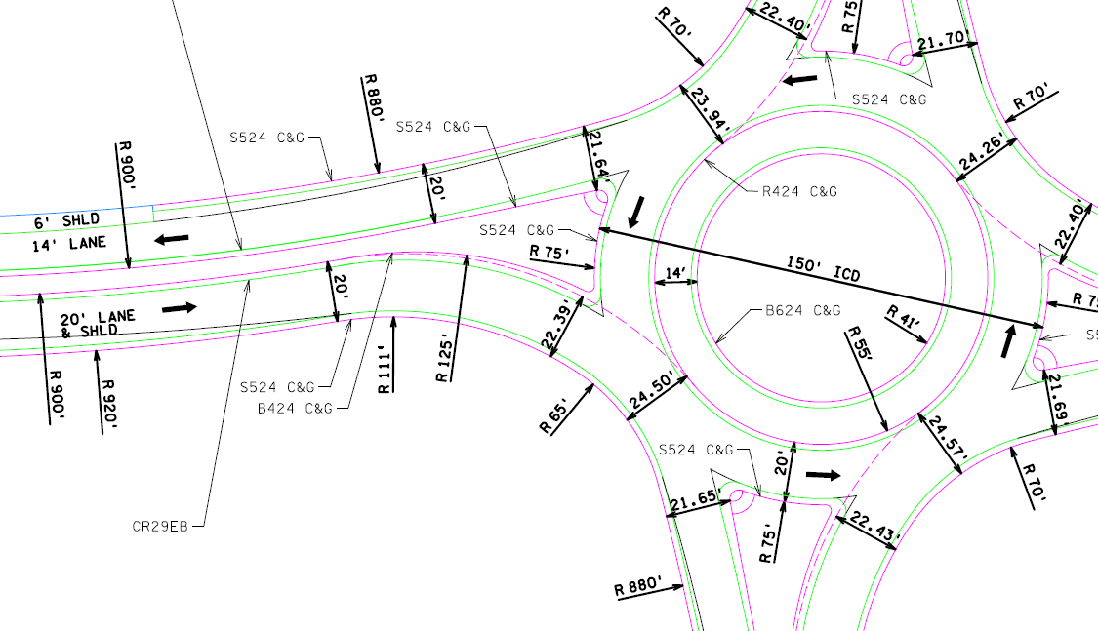
Bonus Topic

Slide 23
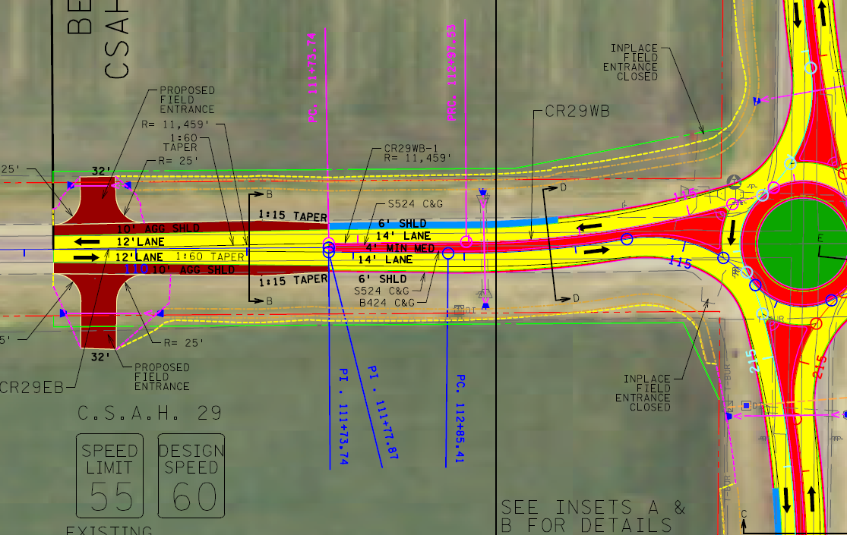
Bonus Topic

