Slide 1
Overview of Guidelines for Applying Microsimulation
Traffic Analysis Tools Volume III Update: Guidelines for Applying Microsimulation
MN SIMCAP
April 2022

Slide 2
Overview of Updated Guidance
Motivation for and updates from the 2004 Guidance
Encourage comprehensive experimental design based on a range of varying travel conditions, rather than a normative “average” day.
Focus calibration and alternatives analysis on the representation of time-dynamic system performance measures including bottleneck formation and dissipation.
Replace with criteria that are statistically valid and derived from observed data.
Develop a calibration process that is data-driven, repeatable, and potentially automatable.
Notes:
Key Messages: The 2018 Volume III Update focuses on the following goals listed on this slide.

Slide 3
Motivation for Updated Guidance
Pre-2004, data was scarce, and traffic analysts had to rely on averages.
  Investment planning was historically based on averages biased towards certain investments (focus in on capital improvements i.e., asphalt and concrete) not managing system reliability.
Now data is more plentiful.
  Travel time data, volume data, weather data, incident data
BUT general nationwide analytical practice is still reliant on averages.
  Even those who have lots of data, groom it and boil it down
  OR, fall into the trap of calibrating to “everything”
We propose a data-driven, statistical method that
  Leverages new integrated data sources
  Enables systematic analytics in Reliability Space through
    Data-driven cluster analysis that identifies distinct travel conditions
    Measure-focused calibration of system dynamics
    Statistical hypothesis testing for alternatives under varying travel conditions
Notes:
Key Messages:
Pre-2004, data were relatively scarce, and simulation analysts were often forced to rely on a set of vehicle count data limited to some larger facilities within the system.
In this era, notions of microsimulation calibration were adapted from travel demand forecasting methods and targeted the accurate reflection of average vehicle counts at detector locations within the network.
New forms of time-dynamic data are now available but often ignored or ineffectively incorporated within simulation studies.
Therefore, we propose a data-driven, statistical method that leverages new integrated data sources and enables systematic analysis in the reliability space.

Slide 4
Guiding Principles of Microsimulation
Ensure the analysis has a clear objective, hypotheses and well-defined performance measures.
Select an appropriate tool.
Budget sufficient analytical resources and time.
Obtain sufficient available data.
Use a model that is calibrated specifically for the study purpose.
Engage stakeholders early and often throughout.
Notes:
Key Messages:
Microsimulation can provide the analyst with valuable information on the performance of the existing transportation system and potential improvements. However, microsimulation can also be a time-consuming and resource-intensive activity.
The key to planning and conducting an effective (and cost-effective) microsimulation analysis revolves around a set of guiding principles listed on this slide.

Slide 5
Recap: the 7 Steps in TAT Volume III
Major Changes in 2019 Update
1
Microsimulation Analysis Planning
2
Data Collection and Analysis
Classifying Travel
Conditions
3
Base Model Development
4
Error Checking
5
Data-Driven
Calibration
Model Calibration
6
Annualized Analysis
Using Statistical
Methods
Alternatives Analysis
7
Final Report
Notes:
Key Messages:
The overall process for developing and applying a microsimulation model to a specific transportation analysis problem consists of seven major tasks.
In order to meet the goals of the update, the 2018 update retains the general structure and intent of the main sections of the 2004 guidebook, with updated materials throughout the document. Significantly enhanced and detailed technical guidance has been included in chapters dealing with data collection and analysis (Chapter 2), model calibration (Chapter 5), and alternatives analysis (Chapter 6).

Slide 6
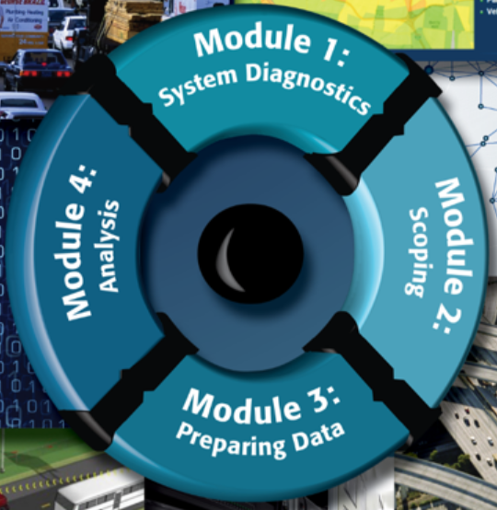
Chapter 1: Microsimulation Analysis Planning
Objectives – To define project purpose, identify project influence
area and analytic time period(s), characterize the alternatives
to be evaluated, select performance measures, develop a general
technical approach (including tool selection) and estimate staff
time and other costs.
Key Points
  Convene stakeholders to develop a clear objective for the analysis.
  Identify alternatives to be analyzed.
  Define what performance measures will differentiate alternatives.
  Determine the scope of the effort (geographic and temporal).
  Prepare an appropriate technical approach.
  Estimate resources.
Image Source: https://ops.fhwa.dot.gov/publications/fhwahop16072/index.htm
Notes:
Key Messages:
Step 1 addresses the management, scope, and organization of microsimulation analyses. In this step, the guidebook describes key issues for the management of a microsimulation study.
This includes defining the project purpose, identifying the project influence area and analytic time period(s), characterizing the alternatives to be evaluated, selecting performance measures, developing a general technical approach (including tool selection) and estimating staff time and other costs.

Slide 7
Chapter 2: Data Collection and analysis
Major Changes in 2019 Update
Objective – To collect and prepare all the data necessary for the microsimulation analysis (including Identify Travel Conditions using Cluster Analysis).
Key Points
  Measure flows and estimate or forecast demand.
  Temporal and geographic scope will impact estimation of demand; so broaden scope to account for onset and dissipation of congestion.
  Ensure flow conservation since it influences analysis.
  Use up-to-date geographic information system (GIS) files, maps and drawings
  Collect contemporaneous data
  Errors in data will make calibration challenging. Ensure data is accurate and verify using field inspection.
Notes:
Key Messages:
Step 2 discusses the steps necessary to collect and prepare input data for use in microsimulation models. This step involves the collection and preparation of all of the data necessary for the microsimulation analysis. Microsimulation models require extensive input data, including: roadway geometry, controls, travel demand, and calibration data, among others.
This step also includes guidance on analyzing contemporaneous data on traffic counts (demand), travel time, weather, and incidents to characterize a set of travel conditions, which is one of the major updates in the 2018 guide.

Slide 8
The danger of applying data-scarce methods in a data-rich environment
Data-Scarce Methods
  Throw out all so-called “abnormal” days:
    Bad weather
    Any day with a crash or incident
    Days with “different” travel demand patterns
      Mondays, Fridays, Holidays, Days Before Holidays…
  Then take an average of whatever is left over
  Supplement any missing data by “stitching in” data taken from many different years, even if there is no logical consistency
Weaknesses of using these methods
  Significant effort spent “grooming” data rather than analyzing
  2/3 or more of days/data ends up being thrown away
  Average days create phantom bottlenecks in the system that cannot be logically represented in simulation (making calibration difficult)
Notes:
Key Messages:
There is a lot of wasted time grooming data when traditional methods are followed
Some of this is related to state guidance that focuses on traffic-count calibration methods originally designed for static planning model calibration
The result is a no-win situation for the simulation analyst
Lots of data grinding
Calibration against unrepresentative targets that may be difficult to replicate in simulation
Dissatisfaction with simulation tools
Time wasted on data grooming and calibration are not recovered in focusing on alternatives analysis

Slide 9
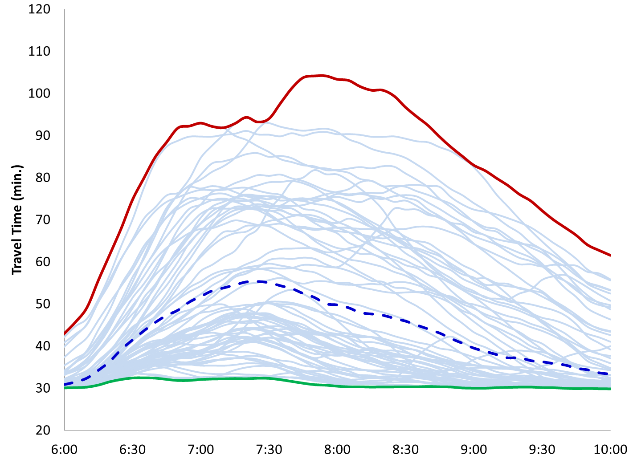
average or “normal” day fails to capture full range of dynamic travel conditions
Real systems have good days and bad days.
Worst Case Travel Time
When we throw out data, and then take an average, we create an artificial day that is not representative.
Average Travel Time
A “normal” day based on an average corresponds to no actual day experience in the system
Best Case Travel Time
Notes:
Key Messages:
A real system has a full range of conditions, both good and bad
As data are thrown out, the analysis becomes less representative
The dotted line here shows the average travel time for a full year in the I-405 corridor near Seattle
Note that there is no “real” day that looks like this day
The dotted line actually sits in a gap between real days, implying that such a day never happened – and might not be possible to actually simulate

Slide 10
Reliability Space Analyses Incorporate Full Spectrum of Travel Conditions
Those who plan and invest for the “normal” day suffer on the vast majority of days that are not “normal”.
MAJOR INCIDENT
Weekend
Construction
On Interstate
Tractor Trailer Fire
During Rush Hour
LOW
DEMAND
“NORMAL”
HIGH
DEMAND
No Accidents
Expected Demand
Clear Weather
Special Event
Snowstorm
EXTREME WEATHER
Goal: Replace “normal” day with data-driven set of distinct travel conditions
Notes:
Key Messages:
Those who plan and invest for the “normal” day suffer on the vast majority of days that are not “normal”, which mean no accidents, expected demand and clear weather.
Real systems experience variations in demand, low to high varying day to day, varying by incident patterns, work zone patterns, as well as the variation in weather.
Using cluster analysis to identify travel conditions reveals a lot more about the system (a full spectrum of travel conditions)
Really leverage the data.
Provide a better and a more insightful feedback to the decision makers to make a call on an important decision
Even the simulation is not needed for analysis, this grouping technique can still help the traffic engineers/decision makers to understand the system dynamic better and make the right decision.

Slide 11
Group Similar Days/Conditions using statistical analysis
35
INCIDENTS
FOG AND RAIN
30
We group observed data using cluster analysis
to identify
distinct travel conditions.
HIGH DEMAND
Travel Time (minutes)
25
LOW DEMAND PLUS WEATHER
MEDIUM DEMAND
20
LOW DEMAND
15
0
30
60
90
120
Bottleneck Duration (minutes)
Notes:
Key Messages:
The system has a lot of variation in it, so we use a simple technique (cluster analysis) to characterize the system.
We group observed data using cluster analysis to identify distinct travel conditions.

Slide 12
Find Representative Days in Each Cluster
35
INCIDENTS
We calculate a centroid for each cluster that is the arithmetic mean performance in the cluster.
FOG AND RAIN
30
HIGH DEMAND
Travel Time (minutes)
centroid
Then, we use relatively simple methods to find an actual day (i.e., representative day) that is closest to the centroid.
25
LOW DEMAND PLUS WEATHER
MEDIUM DEMAND
representative day
20
LOW DEMAND
15
0
30
60
90
120
Bottleneck Duration (minutes)
Notes:
Key Messages:
Data from the days in each cluster used to create a statistical envelope.
We first calculate a centroid for each cluster that is the arithmetic mean performance in the cluster.
Then, we use relatively simple methods to find an actual day that is closest to the centroid. This day is the representative day of the cluster.

Slide 13
Chapter 3: Base Model Development
Objective – To develop a microsimulation model based on available data input tools and techniques.
Key Points
  Geographic scope of study area will impact the alternatives. Broaden scope to look at roadway segments that feed the demand and roadway segments that may be the real bottleneck.
  Temporal scope of the simulation will impact the alternatives. The scope should be broadened to allow congestion to build up and dissipate.
  Base model should reflect the observed field geometry. Overlay the model on a map of the area.
  Assumptions made should be documented so that results can be justified, and sensitivity analyses can be conducted, where applicable.
Notes:
Key Messages:
Step 3 discusses the coding of input data to create a base model. The goal of base model development is a model that is verifiable, reproducible, and accurate.
It is a complex and time-consuming task with steps that are specific to the software used to perform the microsimulation analysis. The details of model development are best covered in software-specific user’s guides.
For this reason, the development process may vary. In the guide, we only provide a general outline of the model development task.

Slide 14
chapter 4: Error Checking
Objective – To identify and correct model coding errors so that they do not interfere with the model calibration task.
Key Points
  Use structured consistent processes.
  Check for “known” bugs and follow recommendations of the developer.
  Use graphical display and animation in the debugging process.
  Conduct an independent review to improve model quality.
Notes:
Key Messages:
Step 4 presents error-checking methods. The error-checking task is necessary to identify and correct model coding errors so that they do not interfere with the model calibration task.
Coding errors can distort the model calibration process and cause the analyst to adopt incorrect values for the calibration parameters.
Error checking involves various tests of the coded network and the demand data to identify input coding errors.

Slide 15
chapter 5: Model Calibration
Major Changes in 2019 Update
Objective – To perform a systematic calibration of the error-free base model developed in Chapter 4 to reproduce observed throughput and other performance measures in travel conditions characterized in Chapter 2.
Key Points
  Calibrate selectively, only for key performance measures.
  Performance measures for calibration must have good observed data.
  Calibrate a model variant for each travel condition.
  Use a representative day approach for calibration rather than a synthetic day combining multiple days.
  Calibration should be focused on bottleneck dynamics as well as time-variant performance measures.
Notes:
Key Messages:
Step 5 provides guidance on a systematic calibration of the error-free base model developed in Step 4 to reproduce observed throughput and other performance measures in travel conditions characterized in Step 2.
This step is also one of the major updates in the 2018 guide. There will be some hands-on exercise for the participants to learn the updated model calibration process.

Slide 16
Calibration Criteria
Define four new calibration criteria.
  Calibration is focused on the dynamics of key performance measures:
    Travel times for key routes
    Bottleneck throughput
Discuss three key steps for performing calibration:
  Identify representative days for each cluster.
  Prepare variation envelopes around the representative day.
  Calibrate model to meet four new criteria.
Notes:
Key Messages:
Please note that calibrating against traffic count data on every link in the network is not recommended
This is a data-scarce technique borrowed from static planning model calibration
Calibration is focused on having the simulation suitably match the rise and fall of key performance measures.
In this module, we will focus on the three key steps in calibration
We will continue to move forward with calibration using the clusters identified in module 3 from the Alligator City example problem

Slide 17
Four new Calibration criteria
Control for maximum number of outliers:
  Constrains the number of outliers in simulated results.
Control for minimum number of inliers:
  Ensures that majority of time-variant simulated results fall close to the representative day.
  Ensures that during the most congested time periods the simulated results are close to the observed data.
Control for bounded average error (BDAE):
  Ensures that on average, simulated results are close to the observed representative day.
Control for bounded systematic error:
  Ensures that simulated data are not excessive over- or under-estimators.
17
Notes:
Key Messages:
We define 4 new criteria.
All four criteria must be met.
If the model fails any one of the four criteria for any key measure, route or location, then you need to go back to adjusting model parameters.
If the model meets all the four criteria for every key measure and associated route/location, then the model is calibrated.

Slide 18
Step 1: Identify Representative Days
Why do we need a representative day?
  It is not efficient to model every day in a cluster since some days are similar.
  It is the target day to build and calibrate the simulation model against – with its specific set of demand, incident, weather, and other attributes.
A representative day has attributes closest to the cluster’s average time-dynamic system performance over all key measures of performance.
  E.g., travel times on key routes AND bottleneck volumes.
DO NOT select different representative days for each measure.
18
Notes:
Key Messages:
The representative day is the analysts’ friend as it is a practical observed set of conditions
Data from a single day is likely to be internally consistent
Incidents have real localized impacts
When data are averaged or created by stitching together data from multiple years calibration can in some cases, be impossible
Leads to a trap where calibration goes on and on until project resources are exhausted
Exactly one representative day identified for each cluster

Slide 19
Step 1: Identify Representative Days (CONT.)
It is not the same as the “average” day in the cluster.
  Picking a representative day considering multiple performance measures means that no single day will exactly conform to the average conditions.
  It is an actual day with clear cause-and-effect relationships between sources of variation (e.g., incidents) and system performance.
centroid
Travel Time (minutes)
representative day
Bottleneck Duration (minutes)
19
Notes:
Key Messages:
A good representative day is a day that best reflects the kind of travel conditions seen across the cluster
Here seeking something near an average is not problematic
Still a real day, but the real day that is closest to the center of the cluster

Slide 20
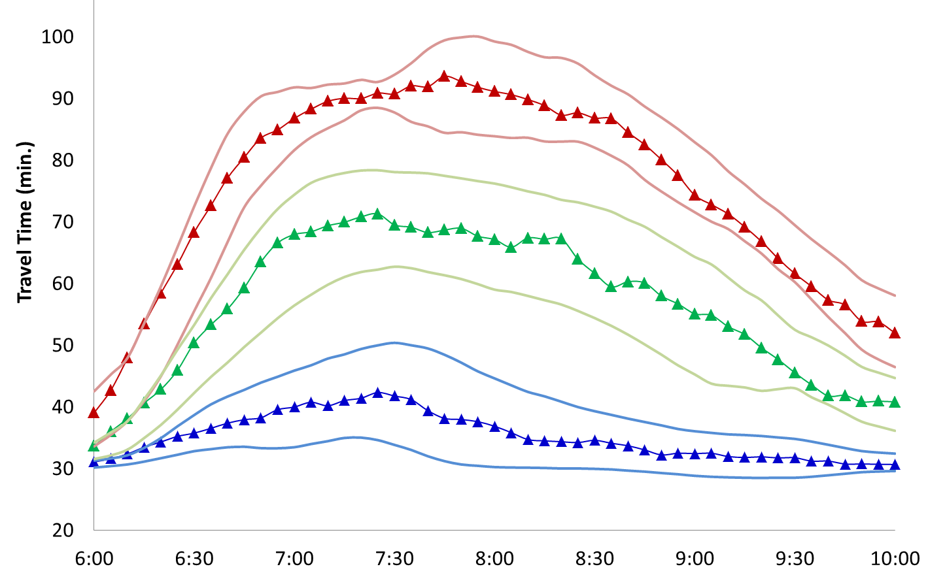
Calibrate for each travel condition using objective, measure-driven criteria
Envelopes Built Using Observed Data
We develop models for representative days in each cluster.
Simulated High Demand Day
Then we calibrate each model against four newly-identified calibration criteria.
Simulated Incidents Day
If a model meets all four criteria for every measure and associated route/location, then the model is calibrated.
Simulated Low Demand Day
Notes:
Key Messages:
We develop models (envelopes) for representative days in each cluster.
Then we calibrate each model against four newly-identified calibration criteria.
If a model meets all four criteria for every measure and associated route/location, then the model is calibrated.
Instead of picking one “normal averaged day”, in the graphic we have three day that can be much a better representation of the system.

Slide 21
Step 2: Prepare Variation Envelopes
The representative day provides a time-dynamic target that our simulation model should reflect.
In this step, we use the time-variant system performance seen across all the days in the cluster to create envelopes around the representative day values.
  These envelopes are the “dartboard” targets for simulated values to fall into.
We will construct two envelopes:
  A “thick” band (μ±2σ) around the representative day.
  A “thin” band (μ±σ) around the representative day.
21
Notes:
Key Messages:
Once we have a representative day, we can start building variation envelopes
There is an envelope for each route/location and measure
The envelopes have two components
A “thick” band around the representative day
A “thin” band around the representative day
We will use each differently when it comes time to assess whether simulation results meet the calibration criteria

Slide 22
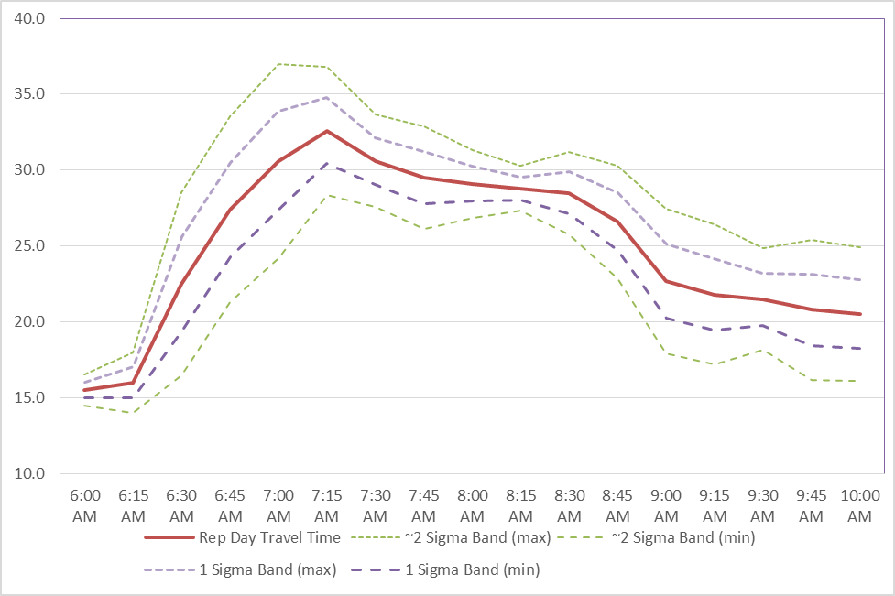
travel time Variation Envelope Graph
Travel time
(min)
Travel time on representative day
Variation of travel time observed
Across all days in the cluster
(travel condition)
Notes:
Key Messages:
This is how the thick and thin bands are plotted for the Komodo Tunnel route
Some time periods have more natural variation than others

Slide 23
Step 3: Calibrate Simulation Model to meet four new acceptability criteria
Define four calibration criteria:
  Control for maximum number of outliers
  Control for minimum number of inliers
  Control for bounded average error
  Control for bounded systematic error
For each specific travel condition (a “do” loop):
  Systematically adjust model parameters associated with system capacity, travel demand, and driver behavior.
  Check to see if the model meets all four calibration criteria for all key measures and routes/locations
  If the model fails any one of the four criteria for any measure, route or location, return to adjust model parameters.
  If the model meets all the four criteria for every measure and associated route/location, then the model is calibrated.
23
Notes:
Key Messages:
Now we have the variation envelopes and are ready to see if our simulation has produced results that meet our calibration criteria
All four criteria must be met

Slide 24
Criterion 1:
Control for Maximum Number of Outliers
Rationale and Criteria:
  WHY: Constrain individual errors associated with outliers in simulated results.
  CRITERIA: 95% of time-variant simulated outputs fall within a band that captures the variability within the cluster around the representative day.
Criterion 1: PASS
24
Notes:
Key Messages:
Visual inspection is a good way to see if this criterion is met
Note that if there are fewer than 20 time slices, at most one value may be outside the 2-sigma envelope

Slide 25
Criterion 2:
Control for Minimum Number of Inliers
Rationale and Criteria:
  WHY: Constrain simulated results to fall closely in line with the representative day.
  CRITERIA: 2/3 of the time variant simulated outputs and two critical time intervals (non-adjacent peak travel times) fall within a narrow band around the representative day.
Criterion 2: PASS
25
Notes:
Key Messages:
Visual inspection is a good way to see if this criterion is met
Generally, if criterion 2 is not met, then criterion 3 is also not met

Slide 26
Criterion 3:
Bounded Average Error
Rationale and Criterion:
  WHY: on average, the time-variant simulated results are close to the observed data.
  A test to ensure that the average simulated absolute error from the representative day over all time intervals is less than or equal to differences from the representative day seen across all days in the cluster.
Statistical Expression:
  Average absolute observed cluster error from
  the representative day.
  Average simulated absolute error
  from the representative day over all time
  intervals is less than or equal to the BDAE threshold.
  : Observed value on rep. day during time interval t
  : Observed value of day i within the cluster during time interval t
  : Simulation value, time interval t
  : Number of time intervals
  : Number of days within the cluster
26
Notes:
Key Messages:
This criterion is best calculated in a separate routine or spreadsheet
The goal is to make sure the simulated day has the same (or less) error than the cluster variation

Slide 27
Criterion 4:
Bounded Systematic Error
Rationale and Criteria
  WHY: Ensure that the simulated data are not excessive over- or under-estimators.
  A test to establish that, on average, the simulation does not systematically over or under estimation of the measure.
Statistical Expression:
  Average simulated error from the representative day over all time intervals is less than or equal to one third of the BDAE threshold.
  : Observed value on rep. day during time interval t
  : Observed value of day i within the cluster during time interval t
  : Simulation value, time interval t
  : Number of time intervals
  : Number of days within the cluster
27
Notes:
Key Messages:
This criterion is best calculated in a separate routine or spreadsheet
The goal is to make sure the simulated day is not consistently an over- or under- estimator of the representative day

Slide 28
chapter 6: Alternative Analysis
Major Changes in 2019 Update
Objective – To use microsimulation models in a well-designed experiment to support an analysis of alternative improvements proposed for the modeled transportation system.
Key Points
  Forecasting major shifts in future travel demand should be analyzed separately from the microsimulation.
  Every alternatives analysis requires multiple runs with different random seeds.
  Randomness in simulation outputs are related to variations in driver behavior models.
  Variation in results from different random seeds are not indicative of first-order system variation, which are due to travel conditions.
  Ensure models are stable and do not create unrealistic gridlock conditions.
Notes:
Key Messages:
Step 6 explains how to use microsimulation models in a well-designed experiment to support an analysis of alternative improvements proposed for the modeled transportation system.
The various improvement alternatives are coded into the simulation model representing each travel condition.
A statistical test is then performed to determine whether any differences between two alternatives are statistically significant.
This step is also one of the major updates in the 2018 guide. There will be some hands-on exercise for the participants to learn the updated alternative analysis process.

Slide 29
Step 1: Represent COMPETING Alternatives
Collaborate with the rest of the project team (designers, engineers, operations staff) to represent alternatives
  Ask clarifying questions about what needs to be evaluated
  Start the process early on in the project, and continue to engage with the design/operations teams
Specifically identify elements that need to be changed in the model to represent the alternatives
  Highly dependent on the selected tool
Notes:
Key Message: Step 1 is about representing the alternatives. You need to start the conversation early with the project team. Find out what exactly is being implemented in each alternative. Try to represent that in the model.

Slide 30
Step 2: run the simulation models
Microsimulation models rely on random numbers to provide non-uniform tactical driver behavior:
  Type and sequencing of vehicles generated at origins
  Tactical decisions about route and gap acceptance
  Aggressiveness in lane changing and gap acceptance behaviors
How do we account for the impacts of the randomness?
  Run the model associated with each alternative and travel condition multiple times using different random seeds
Notes:
Key Message: In step 2, you will run the simulation models.
Microsimulation models represent non-uniform driver behaviors for decisions through use of random numbers.
How do we account for the impacts of the randomness? We can run the model associated with each alternative and travel condition multiple times using different random seeds.

Slide 31
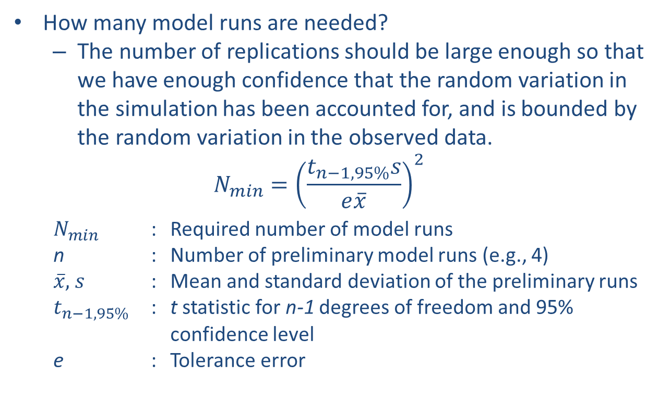
Step 2: run the simulation models (CONT.)
How many model runs are needed?
  The number of replications should be large enough so that we have enough confidence that the random variation in the simulation has been accounted for, and is bounded by the random variation in the observed data.
  $$N_{min}={\left(\frac{t_{n−1, 95\%}s}{e\overline{x}}\right)}^{2}$$
$N_{min}$ : Required number of model runs
    n : Number of preliminary model runs (e.g., 4)
    $\overline{x},$ $s$ : Mean and standard deviation of the preliminary runs
    $t_{n−1, 95\%}$ : t statistic for n-1 degrees of freedom and 95% confidence level
    e : Tolerance error
Notes:
Key Message: The next question is how many runs do we need? It needs to be large enough that we have enough confidence that the random variation in the simulation has been accounted for. But it should be bounded by the random variation in the observed data.
Here is the equation for estimating the required number of runs. We will look into two of the parameters in more detail.
First, let’s look at confidence level. 95% is a traditional default to use. However, it may not always be the best value for every analysis.
We will also discuss tolerance error, e.

Slide 32
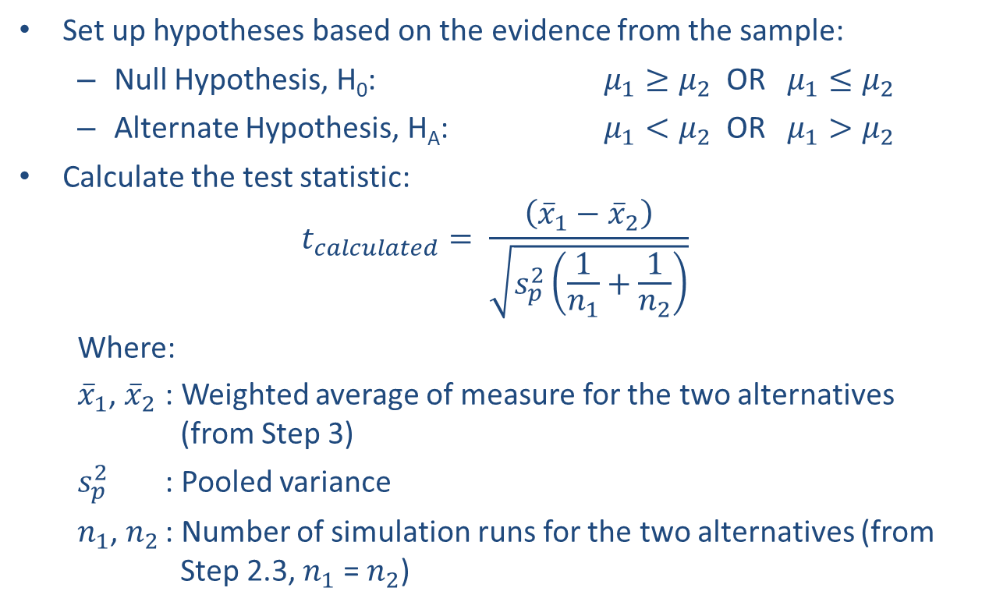
Step 3: Perform Hypotheses Testing
Set up hypotheses based on the evidence from the sample:
  Null Hypothesis, H₀: $μ_{1}≥μ_{2}$ OR $μ_{1}≤μ_{2}$
  Alternate Hypothesis, H_{A}: $μ_{1}<μ_{2}$ OR $μ_{1}>μ_{2}$
Calculate the test statistic:
$$t_{calculated}= \frac{\left({\overline{x}}_{1}−{\overline{x}}_{2}\right)}{\sqrt{s_{p}^{2}\left(\frac{1}{n_{1}}+\frac{1}{n_{2}}\right)}}$$
Where:
${\overline{x}}_{1}$, ${\overline{x}}_{2}$ : Weighted average of measure for the two alternatives (from Step 3)
$s_{p}^{2}$ : Pooled variance
$n_{1}$, $n_{2}$ : Number of simulation runs for the two alternatives (from Step 2.3, $n_{1}$ = $n_{2}$)
Notes:
Key Message: Step 4 is to perform hypothesis testing. You need to set up the hypotheses based on the evidence from the sample or the simulation runs in our case.
If the simulation runs show that Alternative 1 mean is less than Alternative 2 mean, then you should pick the first set of hypotheses (What you see from the runs corresponds to the Alternate Hypothesis). If Alternative 1 mean 1 is greater than Alternative 2 mean, then pick the second set.
Next we will discuss how pooled variance, which is in the denominator of the equation, will be computed.

Slide 33
Step 4: Perform Sensitivity Analysis
Assessing competing alternatives for a future state can be risky
  Uncertainties in forecasts of demand and available capacity
    Changes in future vehicle mix and the timing of travel demand can have a significant impact
    Changes in economic development and public agency approvals of new development can significantly change the amount of future demand
  Slight changes in timing or design of planned capacity improvements outside of study area can significantly change amount of traffic delivered to the study area during the analytical period.
  Good practice to plan for a certain amount of uncertainty
  explicitly in the analysis → Sensitivity Analysis
Notes:
Key Message: We need to account for any uncertainty in forecasts of demand and capacity or assumptions made about driver behaviors, vehicle population, or changes in the system or network outside of the study area that may have an impact.

Slide 34
chapter 7: Final Report
Objective – To summarize the analytical results in a final report and document the analytical approach in a technical document.
Key Points
  Step back and remember your stakeholders may require revisiting the objectives, alternatives, and assumptions to understand the implication of your results.
  Remember to inform decisionmakers, not try to make decisions for them.
  Present your “story” not all the details.
  Document in more detail and preserve analytical artifacts.
Notes:
Key Messages:
Step 7 provides guidance on the documentation of microsimulation model analysis. This step involves summarizing the analytical results in a final report and documenting the analytical approach in a technical document.
This step may also include presentation of study results to technical supervisors, elected officials, and the general public. The final report presents the analytical results in a form that is readily understandable by the decision makers for the project.
The effort involved in summarizing the results for the final report should not be underestimated, since microsimulation models produce a wealth of numerical output that must be tabulated and summarized.

Slide 35

QUESTIONS?

